Slide 1
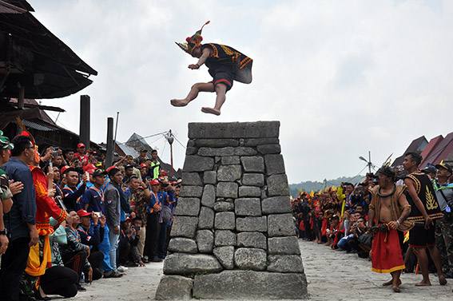
The phonological history of Nias
Towards the next 40 years of Southeast Asian Studies in Frankfurt.
Symposium in honour of Bernd Nothofer
Frankfurt, 19 Dec 2021
© ANTARA FOTO
Erik Zobel

Slide 2
Background
Endonym: Li Niha
Spoken on Nias and the Batu Islands (North Sumatra)
c. 1,000,000 speakers (based on ethnic population 2011)
Vigorous usage + positive language attitudes (Ethnologue)
Bible translation + church services
Nias Wikipedia + Wiktionary
Three main dialect areas (Northern, Central, Southern)
Barrier Islands-Batak subgroup: Sikhule; Mentawai, Enggano, Simalur Gayo + Batak languages = "Sumatran" (Smith 2017, who also includes Nasal)

Slide 3
Nias
Batu Isl.
Sumatra
Mentawai Islands

Slide 4
Earlier literature
Dictionaries
Sundermann (1905)
Laiya (1985)
Lase (2011)
Historical phonology
Lafeber (1922)
Kähler (1937)
Nothofer (1986)
Blust (ACD, work-in-progress)

Slide 5
Nias sound system - Vowels
 | front | central | back (unrounded) | back (rounded)
high | i |  |  | u
mid | e |  | ɤ | o
low |  | a
/ɤ/ is realized as [ɤ ∼ ɘ ∼ ɨ]
Stress is mostly on the penult of the root. Roots with final stress include: amí 'you (pl.)', mané 'thus; say so'
Minimal pair:
owí 'tonight' ∼ ówi 'to cut weed'

Slide 6
Nias sound system - Consonants
 | labial | alveolar | palatal | velar | glottal
voiceless stop | (p) | t | (c) | k | ʔ
voiced stop | b | d |  | g
prenasalized stop | mb | ndr
voiceless fricative | f | s |  | x | h
voiced fricative |  | z
nasal | m | n |  | ŋ
trill |  | r
lateral |  | l
approximant | ʋ |  | y | w
No final consonants, no consonant clusters: (CV)CVCV

Slide 7
Spelling conventions
[ɤ] ö (also õ)
[ʋ] w
[w] ŵ (also w̃)
[ʔ] '
[x] kh
[ŋ] ng

Slide 8
Initial mutation
f > w fakhe ∼ wakhe 'rice'
t > d tanö ∼ danö 'land'
s > z si'u ∼ zi'u 'elbow'
b > mb bua ∼ mbua 'fruit'
d > ndr du'u ∼ ndru'u 'grass'
k > g kefe ∼ gefe 'money'
V- > gV-/nV- asu ∼ nasu 'dog'; ahe ∼ gahe 'foot'
Historically: N + C

Slide 9
PMP sound system - Vowels
 | front | central | back
high | *i |  | *u
mid |  | *ə
low |  | *a
Final diphthongs: *-aw, *-ay, *-uy, *-iw

Slide 10
PMP sound system - Consonants
 | labial | apical | palatal | velar | uvular/ glottal
voiceless stop | *p | *t | *c |  | *q
voiced stop | *b | *d | *z
fricative |  | *s | *j | *R | *h
nasal | *m | *n | *ñ | *ŋ
trill |  | *r
lateral |  | *l
semivowel |  |  | *y | *w

Slide 11
From PMP to Nias - Vowels
Basic vowel reflexes
*a > a *sawa > saŵa
*i > i *piliq > fili
*u > u *bunuq > bunu
*ə > ö *ənəm > önö
*-ay > -e *matay > mate
*-aw > -ö *bañaw > banö
*-uy, *-iw > i *babuy > bawi; *laRiw > loi
Note: *a, *u, *ə > o in certain environments

Slide 12
From PMP to Nias - Consonants
One-to-one reflexes
*p > f *pitu > fitu
*t > t *tanəq > tanö
*k > ' *takut > ta'u
*m > m *matay > mate
*ŋ > ng *haŋin > angi
*l > l *lima > lima
*r > r *garut > kharu
*y > y *layaR > loyo
*w > ŵ *siwa > siŵa

Slide 13
From PMP to Nias - Consonants
Conditioned changes/mergers
*b > b (initial) *buaq > bua > w (medial) *təbuh > töwu
*d/*z > d (initial) *daRaq > do; *zukut > du'u > r (medial) *qudaŋ > uro; *tazəm > tarö
*g/*j > kh *pajay > fakhe; *Ragəm > okhö
*s/*c > s *basəq > a-basö; (*pacək > fasa)
*n/*ñ > n *nanaq > nana; *bañaw > banö

Slide 14
From PMP to Nias - Consonants
Nasal clusters
*mp > w *sumpaq > suwa
*nt > d *buntu > budu
*ŋk > g *saŋkəp > sagö
*mb > mb *umbul > umbu
*nd > ndr *tanduk > tandru
Note: This sound change also underlies synchronic nasal mutation

Slide 15
From PMP to Nias - Consonants
Loss of final consonants
*qunap > huna
*qitəm > itö
*laŋit > langi
*lahud > löu
*haŋin > angi
*gigil > gikhi
*nipis > nifi
*pusəj > fusö
*manuk > manu
*qijuŋ > ikhu
*pənuq > fönu
*tubah > tuwa

Slide 16
From PMP to Nias - Consonants
Reflexes of *q
Retained as h
*qaRus > hou
*qunəj > hunö
*qətut > hötu
*baqəRu > bohou
*paqa > faha
*Raqan > oha
Complete loss
*quay > ue
*qudaŋ > uro
*qatay > ate
*taqi > tai
*buqaya > buaya
*tuqəlaŋ > töla
Note: the mutated form either begins with g- or n-

Slide 17
From PMP to Nias - Consonants
Complete loss of *h
Loss of initial *k
*hutək > uto
*haŋin > angi
*hikan > i'a
*haRəzan > ora
*ihəq > iö
*lahud > löu
Note: the mutated form either begins with g- or n-
*kulit > uli
*kahiw > eu
*kapi(C) > afi
*kutu > utu
Note: the mutated form always begins with g-

Slide 18
From PMP to Nias – Vowel coloring
*a/*ə > o before final *k/*ŋ
*tuak > tuo
*qudaŋ > uro
*pinaŋ > fino
*hutək > uto
*latəŋ > lato
*qajəŋ > ahko
Note: *u is not affected
*tanduk > tandru
*ləsuŋ > lösu

Slide 19
From PMP to Nias – Vowel coloring
Regressive *R-coloring
Progressive *R-coloring
*paRi > foi
*qaRus > hou
*bəRŋi > bongi
*duRi > doi
*puRu > fou
*sinaR > sino
*saləR > salo
*ikuR > i'o
*Ratas > ota
*Raqan > oha
*Rəbəq > owö
*Rusuk > osu
*biRaq > bio
*uRat > uo
*baRəq > bao
*gaRuk > khao

Slide 20
From PMP to Nias – Vowel coloring
Bidirectional *R-coloring
Metathesis *ə -*u
*daRaq > do
*baRah > bo
*baRaq > bo
*paRa > fo
*haRəzan > ora
*qatəluR > adulo
*bəsuR > buso
*qənuR > huno

Slide 21
From PMP to Nias – Vowel coloring
Vowel harmony before *k/*ŋ/*R
(*ə-ə; *a-a; *ə-a; but not *a-ə)
*anak > ono
*bətak > a-boto
*qabaŋ > owo
*qənəŋ > hono
*lapaR > lofo
*dəŋəR > rongo
but:
*latəŋ > lato
*qajəŋ > akho

Slide 22
From PMP to Nias – irregularities
Mutation
"Root" correspondences
*tuqu ∼ du'u
*tumpaq ∼ duwa
*kasaw ∼ gasö
*qubi ∼ gowi
*kəna ∼ göna
*kaŋkaŋ ∼ a'ega
*ləpas ∼ efa-'ö
*gətus ∼ aetu
*i dipaR ∼ yefo
*susu ∼ fosu

Slide 23
Barrier Islands-Batak relations
Shared irregularties
*qaləp (*qalap) > halö (Simalungun alop)
*Rəbəq (*Rəbaq) > owö (Simalungun roboh, Toba robo)
*taŋkaw (*takaw) > tagö (Karo tangko, Toba takko)

Slide 24
Barrier Islands-Batak relations
Shared with all Barrier Islands-Batak languages
Merger of *d and *z (common)
Merger of *g and *j (rare)
Shared with Mentawai
Coloring effect of *R on neighboring vowels (rare)
Shared with Toba and Angkola-Mandailing
Merger of *ə and *aw (common)

Slide 25
Barrier Islands-Batak relations
*begu 'ghost, spirit': Nias bekhu, Toba/Karo begu
*dəgil 'scrape': Nias dökhi, Simalungun dogil; Toba dogil 'knead'
*dugu 'rub': Nias dukhu, Toba dugu, Enggano duhuki
*labaq 'door': Nias lawa, Karo/Simalungun labah (distinct from PMP *lawaŋ!)
*qagaw 'wear out': Nias a-hakhö, Toba ago, Karo ago
*Rabi 'cut weeds, clear land': Nias owi, Toba/Karo rabi
*təRuq 'below': Nias tou, Simalur atəlu, Toba toru, Karo təruh, Gayo tuyuh

Slide 26
References
Blust, Robert (work-in-progress). Austronesian Comparative Dictionary. Online resource, https://www.trussel2.com/acd.
Eberhard, D., Simons, G. and Fennig, C. (2021). Ethnologue. Dallas: SIL International.
Kähler, Hans (1937). "Untersuchungen über die Laut-, Wort- und Satzlehre des Nias". Zeitschrift für Eingeborenensprachen 27: 91-128, 212-222, 261-288.
Lafeber, Abraham (1922). Vergelijkende klankleer van het Niasisch. s'-Gravenhage: Hadi Poestaka.
Laiya, Sitasi Z. (1985). Kamus Nias-Indonesia. Jakarta: Pusat Pembinaan dan Pangembangan Bahasa.
Lase, Apolonius (2011). Kamus Li Niha / Nias-Indonesia. Jakarta: Kompas.
Nothofer, Bernd (1986). "The Barrier Island Languages in the Austronesian Language Family". In Geraghty, P., Carrington, L. and Wurm, S.A. (eds.) Focal II: Papers From the Fourth International Conference on Austronesian Linguistics, 87-109. Canberra: Pacific Linguistics.
Smith, Alexander D. (2017). "The Western Malayo-Polynesian Problem". Oceanic Linguistics 56(2): 435-490.
Sundermann, Heinrich (1905). Niassisch-deutsches Wörterbuch. Moers: Bataviaasch Genootschap van Kunsten en Wetenschappen.

Slide 27
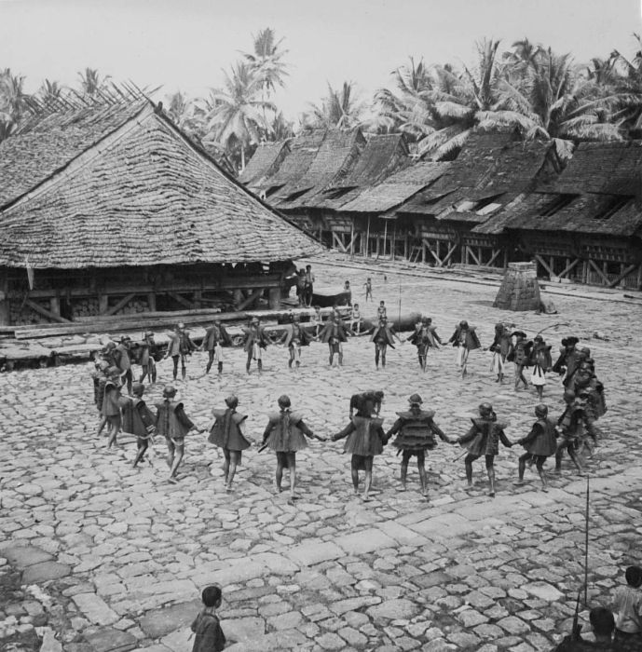
Saohagölö!

